Slide 1

Student Registration Project
Gino De Paoli
CST 499: Capstone for Computer Software Technology
Dr. Amr Elchouemi

Slide 2
SRS Document
The software requirements specification document
Why do we need it?
Gives us the product scope
Documents the functional and non-functional requirements given by the stakeholders
High level over view of the software system

Slide 3
SRS Continued
Create documentation that will be maintained for people who have questions
Go over the external interfaces the system will be interacting with both hardware and software
List the system features that are the main focus
Finally go over any wish list items that are desired by the stake holders

Slide 4
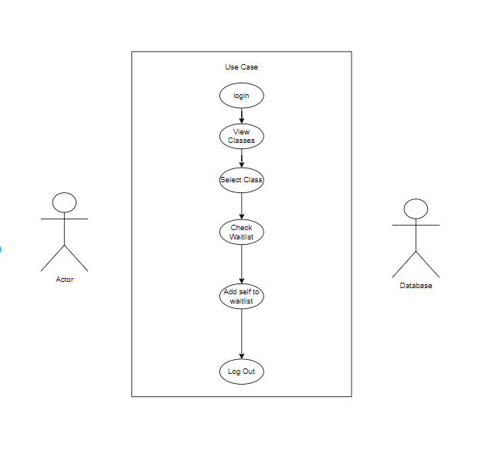
UML Diagrams

Slide 5
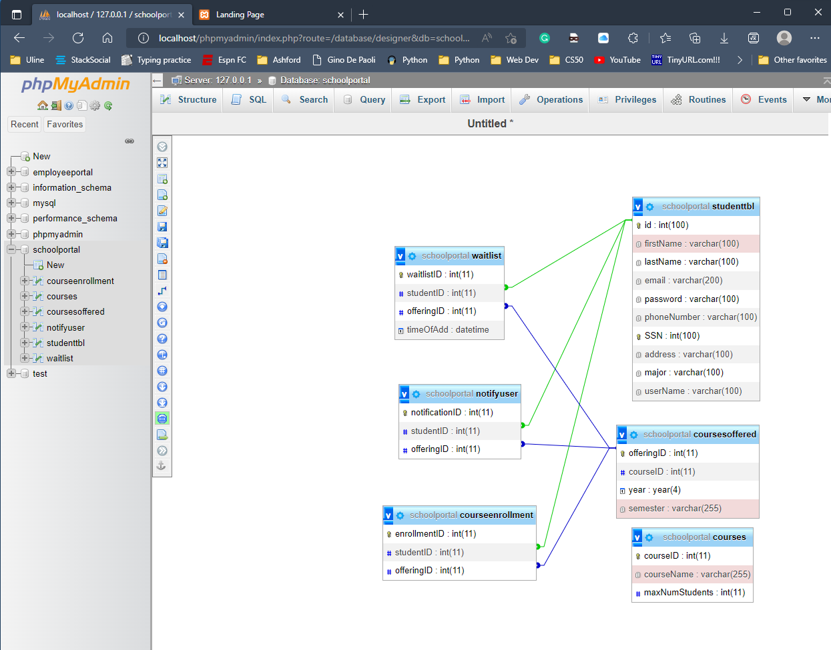
UML Continued

Slide 6
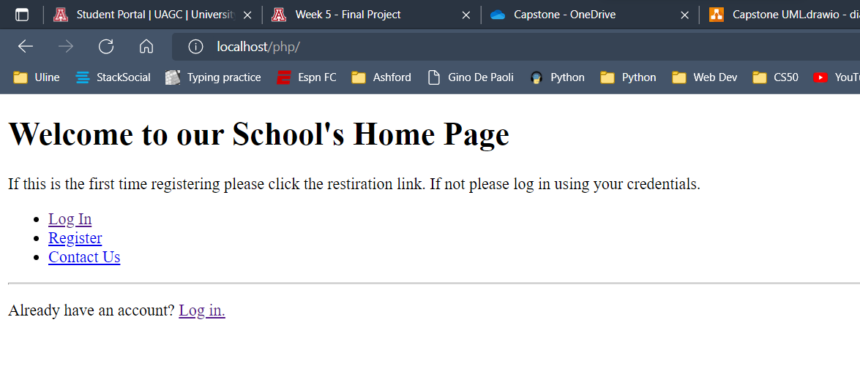
Landing Page

Slide 7
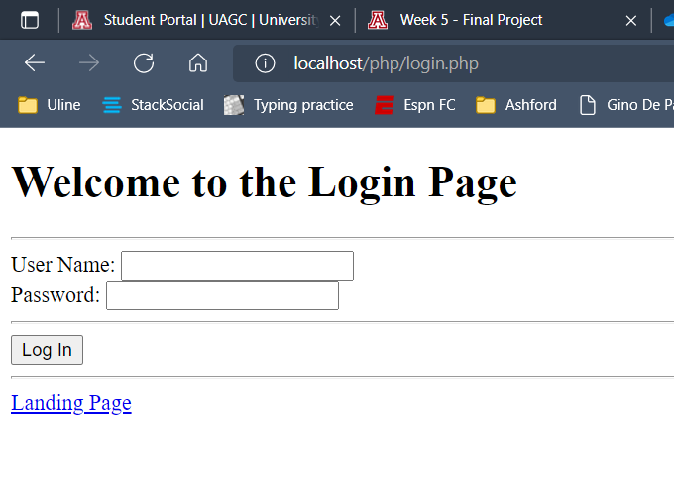
Login

Slide 8
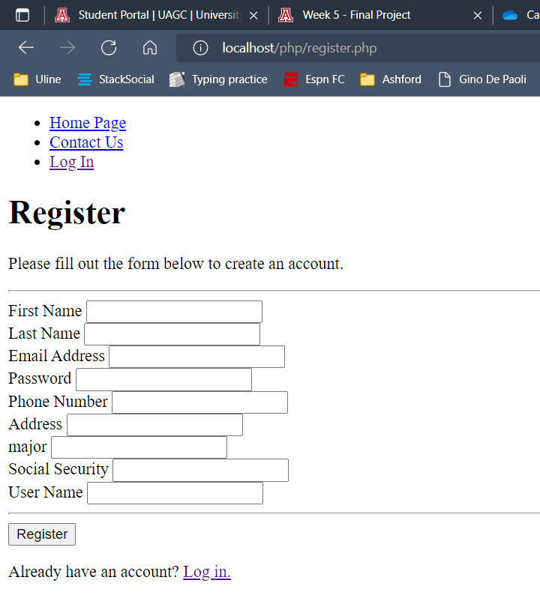
Enrollment Pages

Slide 9
PHPMYAdmin

Slide 10

VS Code Demo

